Slide 1
Privacy Preservation in Distributed Deep Learning
Applications
Akash Govind Kuttikad
CS 498 - Trustworthy ML -Fall 2022

Slide 2
Contents
Introduction
Objective
Modelling
Sample Attacks
Results
CS 498, Trustworthy ML

Slide 3
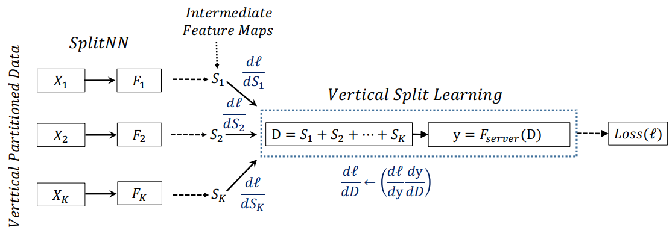

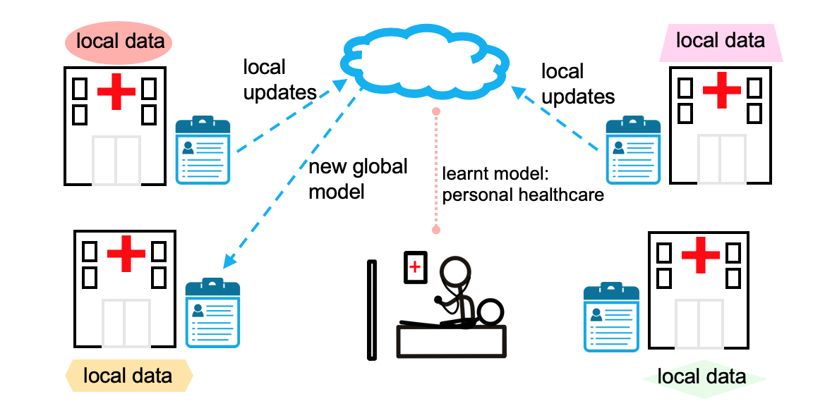
Introduction
Introduction
Modelling
Sample Attacks
Results
Objective
Distributed deep learning/Split learning – Latent representation of input data is sent to the subsequent part through an intermediate layer
Reverse-engineering input data through such intermediate representation is not a huge challenge
Song et. al. [1] have shown that attacks on popular sentence embeddings (encoded representations in NLP) not only recover between 50%–70% of the input words, but also might reveal sensitive attributes inherent in inputs.
Example
Reconstruct
Input Data
CS 498, Trustworthy ML

Slide 4
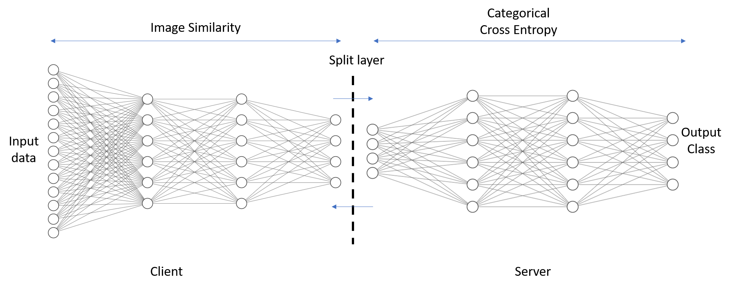
Objective
Introduction
Modelling
Sample Attacks
Results
Objective
Vertical split learning was first introduced by Gupta & Raskar [2] in 2018, and has been studied extensively in literature as a baseline architecture for several privacy preserving models.
X → Z → Ŷ
Modify the objective function to include a D_{corr} (X, Z) term and jointly optimize along with cross-entropy loss.
$$Objective= L_{CrossEntropy}\left(X,Y\right)+ α D_{corr}(X,Z)$$
CS 498, Trustworthy ML

Slide 5
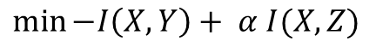
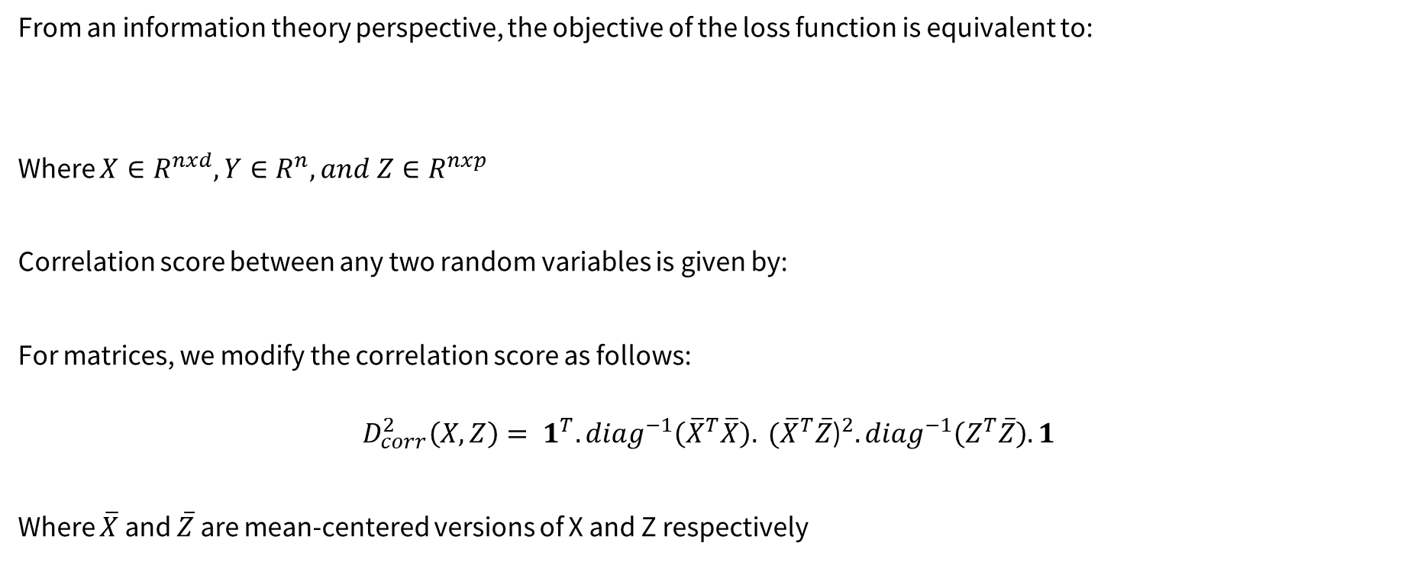
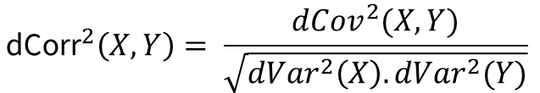
Modelling
Introduction
Modelling
Sample Attacks
Results
Objective
From an information theory perspective, the objective of the loss function is equivalent to:
Where $X∈R^{nxd},Y∈R^{n}, and Z∈R^{nxp}$
Correlation score between any two random variables is given by:
For matrices, we modify the correlation score as follows:
$$D_{corr}^{2}\left(X,Z\right)= 1^{T}.{diag}^{−1}\left({\overline{X}}^{T}\overline{X}\right). {({\overline{X}}^{T}\overline{Z}\text{)}}^{2}.{diag}^{−1}\left(Z^{T}\overline{Z}\right).1$$
Where $\overline{X}$ and $\overline{Z}$ are mean-centered versions of X and Z respectively
$$\min{−I\left(X,Y\right)+ α I(X,Z)}$$
$${\text{dCorr}}^{2}\left(X,Y\right)= \frac{{dCov}^{2}(X,Y)}{\sqrt{{dVar}^{2}\left(X\right).{dVar}^{2}(Y)}}$$
CS 498, Trustworthy ML

Slide 6
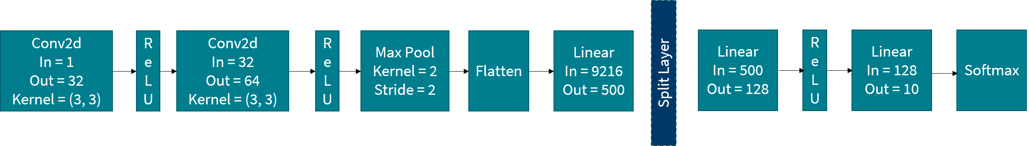
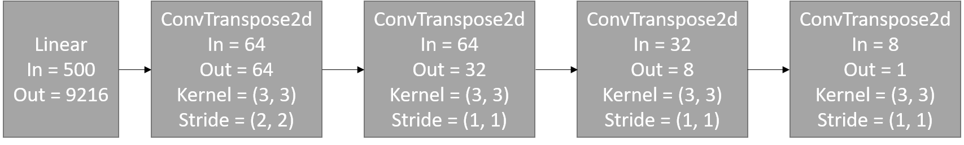
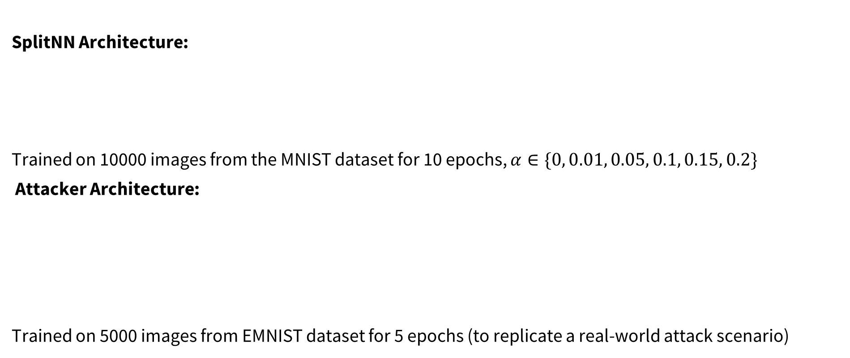
Modelling
Introduction
Modelling
Sample Attacks
Results
Objective
SplitNN Architecture:
Trained on 10000 images from the MNIST dataset for 10 epochs, $α∈\{0, 0.01, 0.05, 0.1, 0.15, 0.2\}$
Attacker Architecture:
Trained on 5000 images from EMNIST dataset for 5 epochs (to replicate a real-world attack scenario)
CS 498, Trustworthy ML

Slide 7
Sample Attacks
Introduction
Modelling
Sample Attacks
Results
Objective
Can you guess what are the numbers that the attacker attempts to reconstruct?
CS 498, Trustworthy ML

Slide 8
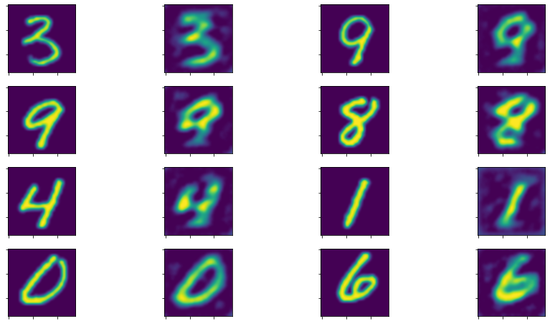
Sample Attacks
Introduction
Modelling
Sample Attacks
Results
Objective
Can you guess what are the numbers that the attacker attempts to reconstruct?
Attacker
Reconstruction
CS 498, Trustworthy ML

Slide 9
Sample Attacks
Introduction
Modelling
Sample Attacks
Results
Objective
Can you guess what are the numbers that the attacker attempts to reconstruct?
Attacker
Reconstruction
Ground
Truth
CS 498, Trustworthy ML

Slide 10
Sample Attacks
Introduction
Modelling
Sample Attacks
Results
Objective
Can you guess what are the numbers that the attacker attempts to reconstruct?
Attacker
Reconstruction
Ground
Truth
⇒ α = 0
No privacy!
CS 498, Trustworthy ML

Slide 11
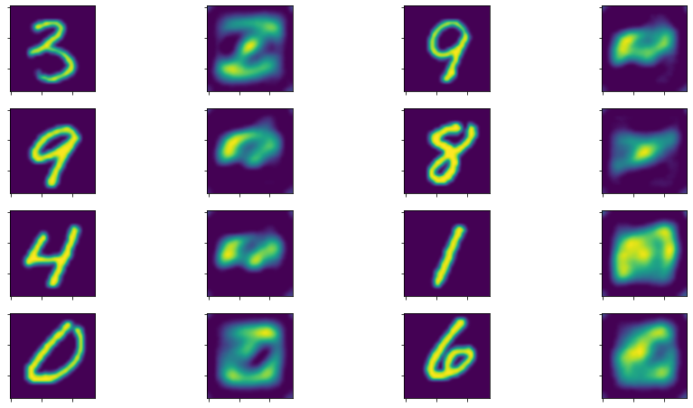
Sample Attacks
Introduction
Modelling
Sample Attacks
Results
Objective
Can you guess what are the numbers that the attacker attempts to reconstruct?
Attacker
Reconstruction
Ground
Truth
Attacker
Reconstruction
⇒ α = 0
No privacy!
CS 498, Trustworthy ML

Slide 12
Sample Attacks
Introduction
Modelling
Sample Attacks
Results
Objective
Can you guess what are the numbers that the attacker attempts to reconstruct?
Attacker
Reconstruction
Ground
Truth
Attacker
Reconstruction
Ground
Truth
⇒ α = 0
No privacy!
CS 498, Trustworthy ML

Slide 13
Sample Attacks
Introduction
Modelling
Sample Attacks
Results
Objective
Can you guess what are the numbers that the attacker attempts to reconstruct?
Attacker
Reconstruction
Ground
Truth
Attacker
Reconstruction
Ground
Truth
⇒ α = 0
No privacy!
⇒ α = 0.1
Ground Truth
Masked!
CS 498, Trustworthy ML

Slide 14
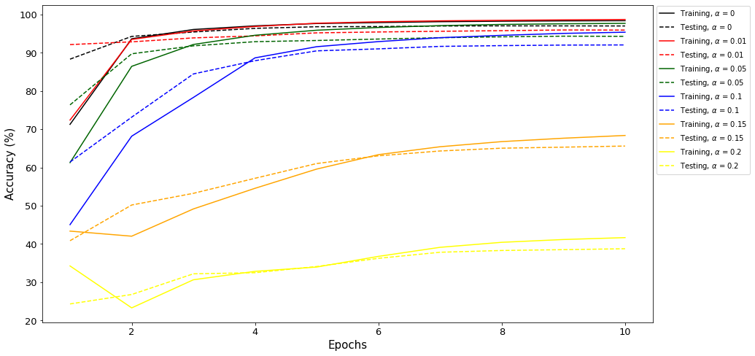

Results
Introduction
Modelling
Sample Attacks
Results
Objective
Test-train curves for various values of α:
Trade-off between
Accuracy and Privacy
CS 498, Trustworthy ML

Slide 15
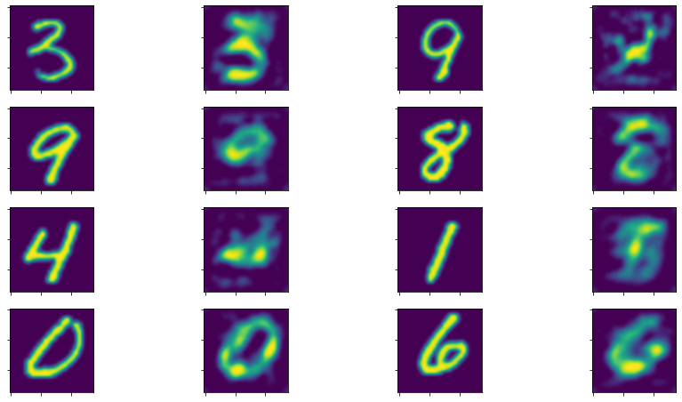
Results
Introduction
Modelling
Sample Attacks
Results
Objective
Reconstruction Attacks for varying α:
α = 0
α = 0.01
CS 498, Trustworthy ML

Slide 16
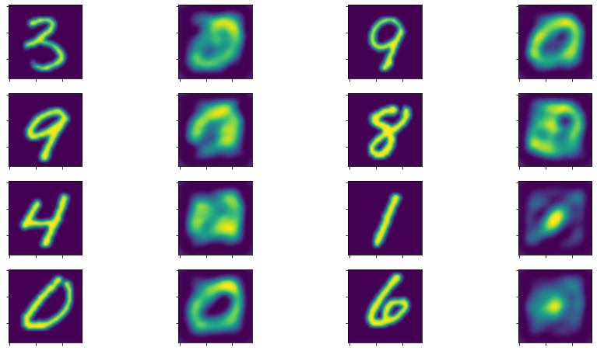
Results
Introduction
Modelling
Sample Attacks
Results
Objective
Reconstruction Attacks for varying α:
α = 0.05
α = 0.1
CS 498, Trustworthy ML

Slide 17
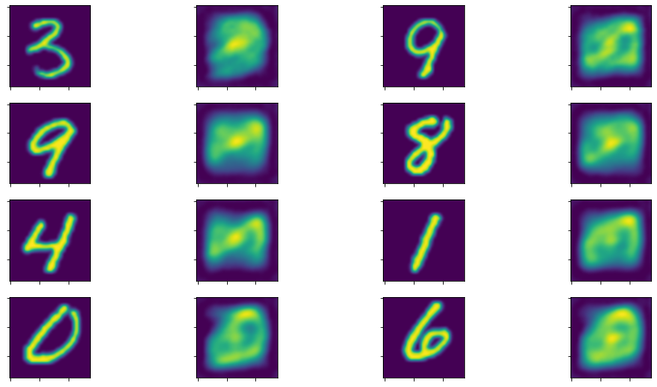
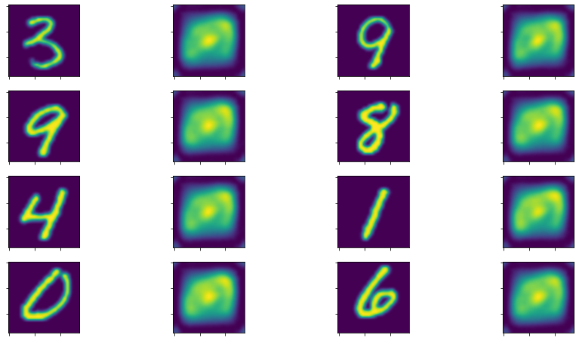
Results
Introduction
Modelling
Sample Attacks
Results
Objective
Reconstruction Attacks for varying α:
α = 0.15
α = 0.2
CS 498, Trustworthy ML

Slide 18
Thank You!
References:
[1] Congzheng Song and Ananth Raghunathan. 2020. Information Leakage in Embedding Models. In Proceedings of the 2020 ACM SIGSAC Conference on Computer and Communications Security (CCS '20). Association for Computing Machinery, New York, NY, USA, 377–390.
[2] Gupta, Otrkist, & Raskar, Ramesh. 2018. Distributed learning of deep neural network over multiple agents. arXiv preprint arXiv:1810.06060
CS 498, Trustworthy ML

